Slide 1


Introduction to Xamarin
Jim Bennett
Senior Cloud Developer Advocate
@JimBobBennett
jimbobbennett.io
Notes:
Ask:
Who has phone?
iOS? Android?

Slide 2

iOS
Android
Windows
Objective-C/Swift
Xcode
Java/Kotlin
Android Studio
C#
Visual Studio
No shared code • Many languages and development environments
@JimBobBennett
Aka.ms/XamDocs
Notes:
Traditional way
Duplicate code – ToDo as example
Takes much longer

Slide 3
Xamarin’s unique approach
iOS C# UI
Android C# UI
Windows C# UI
Shared C# logic
Shared C# codebase • 100% native API access • High performance
@JimBobBennett
Aka.ms/XamDocs
Notes:
Native, but in shared language
Thin Wrappers around native SDKs – UIViewController. Activity
As fast as native, feature parity easy, 70% shared code

Slide 4



Xamarin Native—Traditional UI
iOS C#
Android C#
Windows C#
Shared C# Logic
3 Native User Interfaces
Shared App Logic
@JimBobBennett
Aka.ms/XamDocs
Notes:
Storyboards and Android XML
SAME as on native
Recources can be copied from native apps

Slide 5

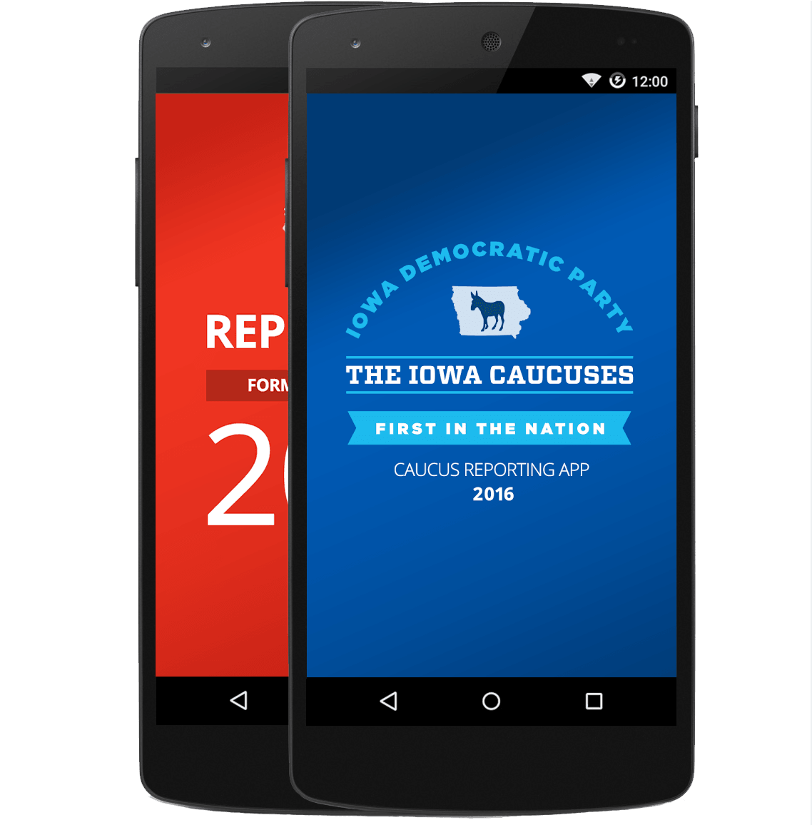
Xamarin.Forms—Cross Platform UI
Shared UI Code
Shared C# Logic
Shared Native User Interface
Shared App Logic
@JimBobBennett
Aka.ms/XamDocs
Notes:
Forms – originally designed for fast forms over data
Now powerful cross platform toolkit
Native – just an abstraction

Slide 6
Jim Bennett
Senior Cloud Developer Advocate
@JimBobBennett
jimbobbennett.io
Getting started with Xamarin aka.ms/xamdocs
Xamarin.Forms
aka.ms/xamformsdocs
Xamarin University
university.xamarin.com
Azure for students
aka.ms/azureimperial

